Slide 2
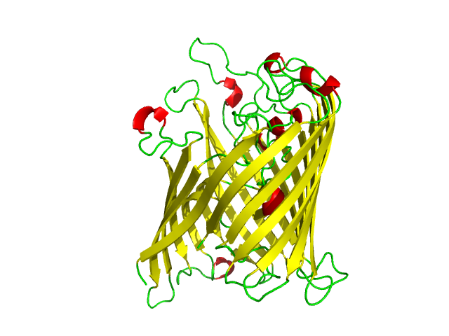
Outer Membrane Proteins Are Beta Barrels

Slide 3

Ezβ Estimates Insertion Energy
Energy of leucine

Slide 4
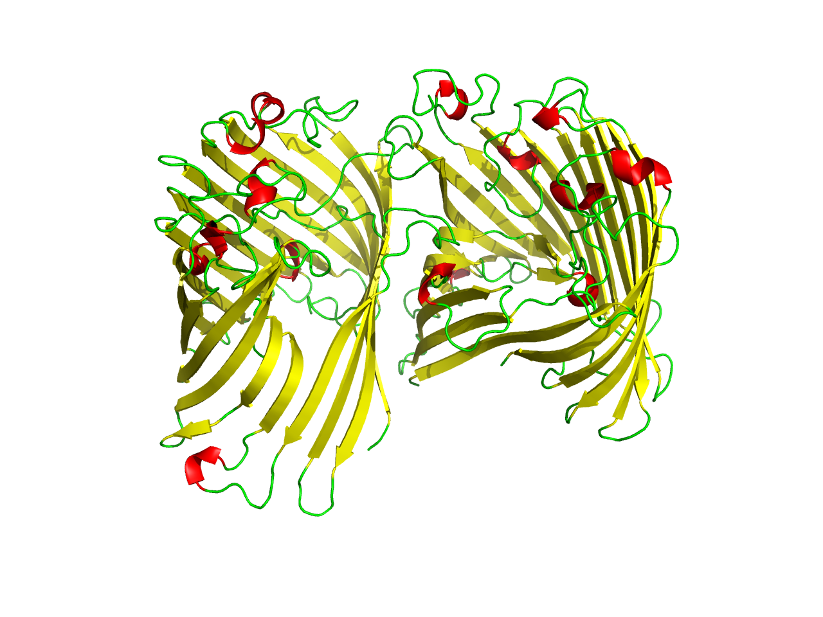
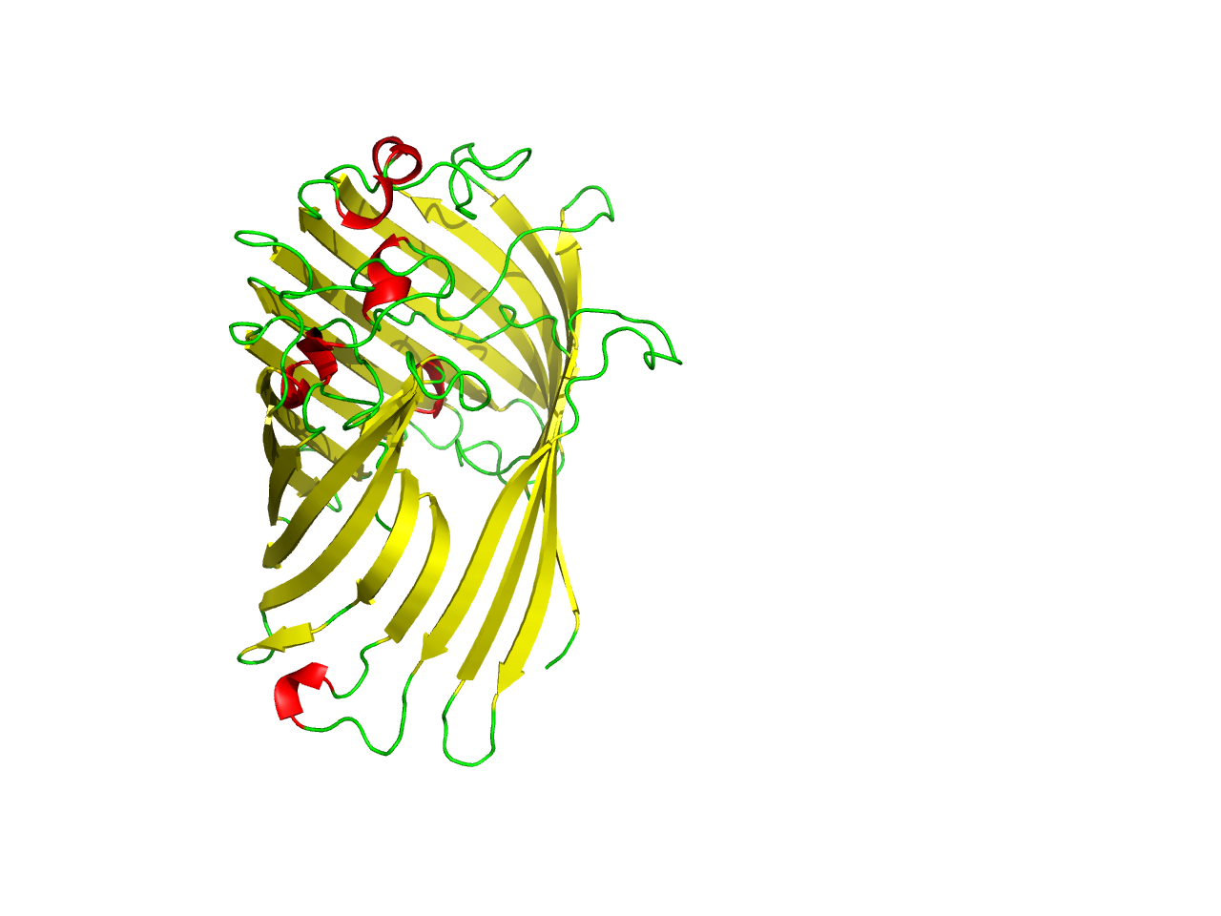
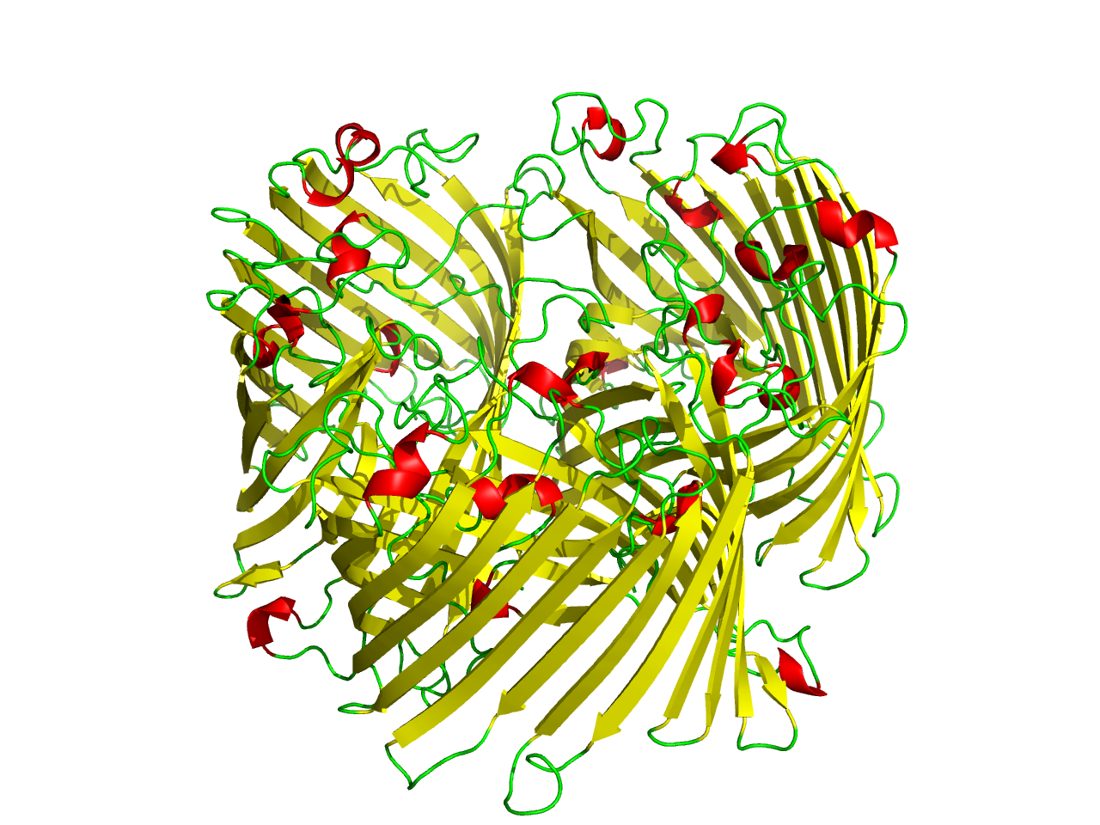
Some OMPs are oligomers

Slide 5
We thought protein-protein interfaces would have elevated insertion energy

Slide 6
The Ezβ Moment Quantifies Local Elevation of Insertion Energy

Slide 7
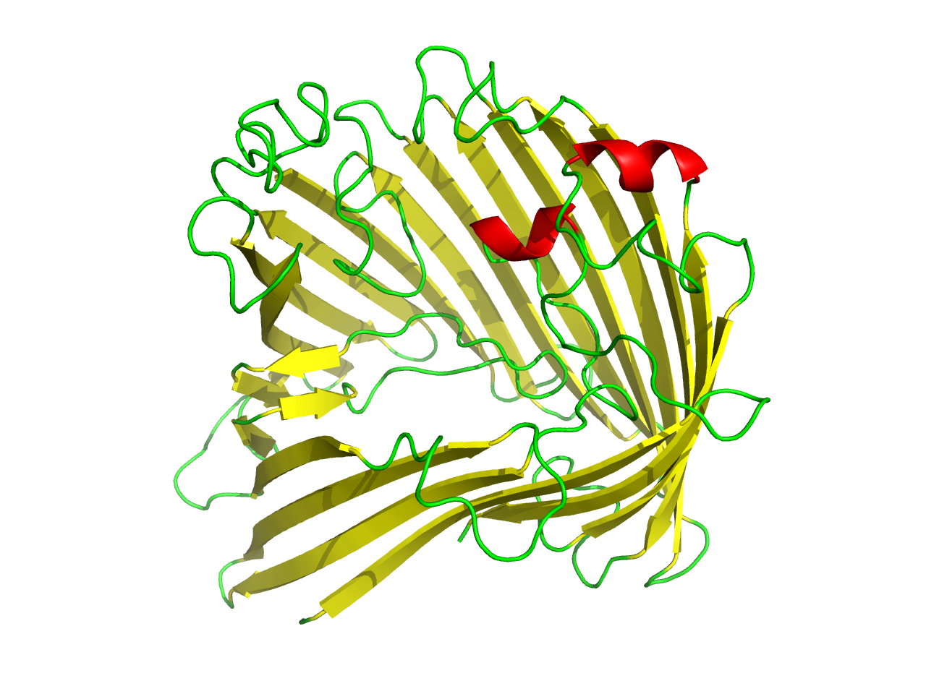
The Ezβ Moment Quantifies Local Elevation of Insertion Energy

Slide 8
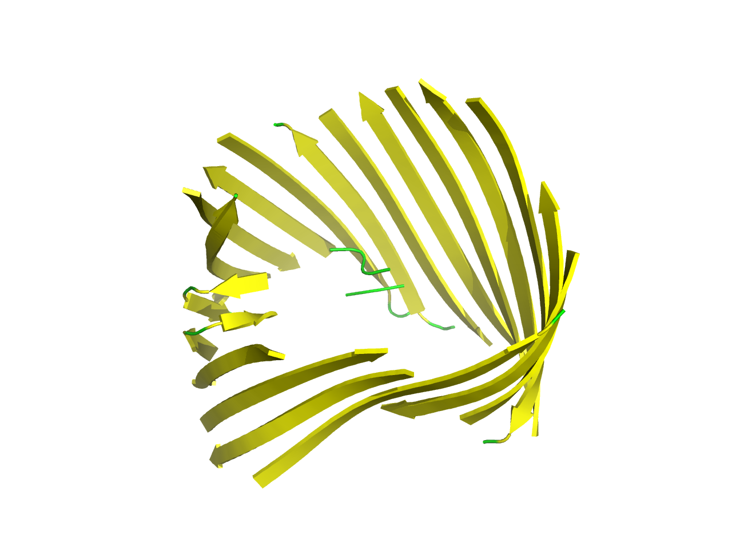
The Ezβ Moment Quantifies Local Elevation of Insertion Energy

Slide 9
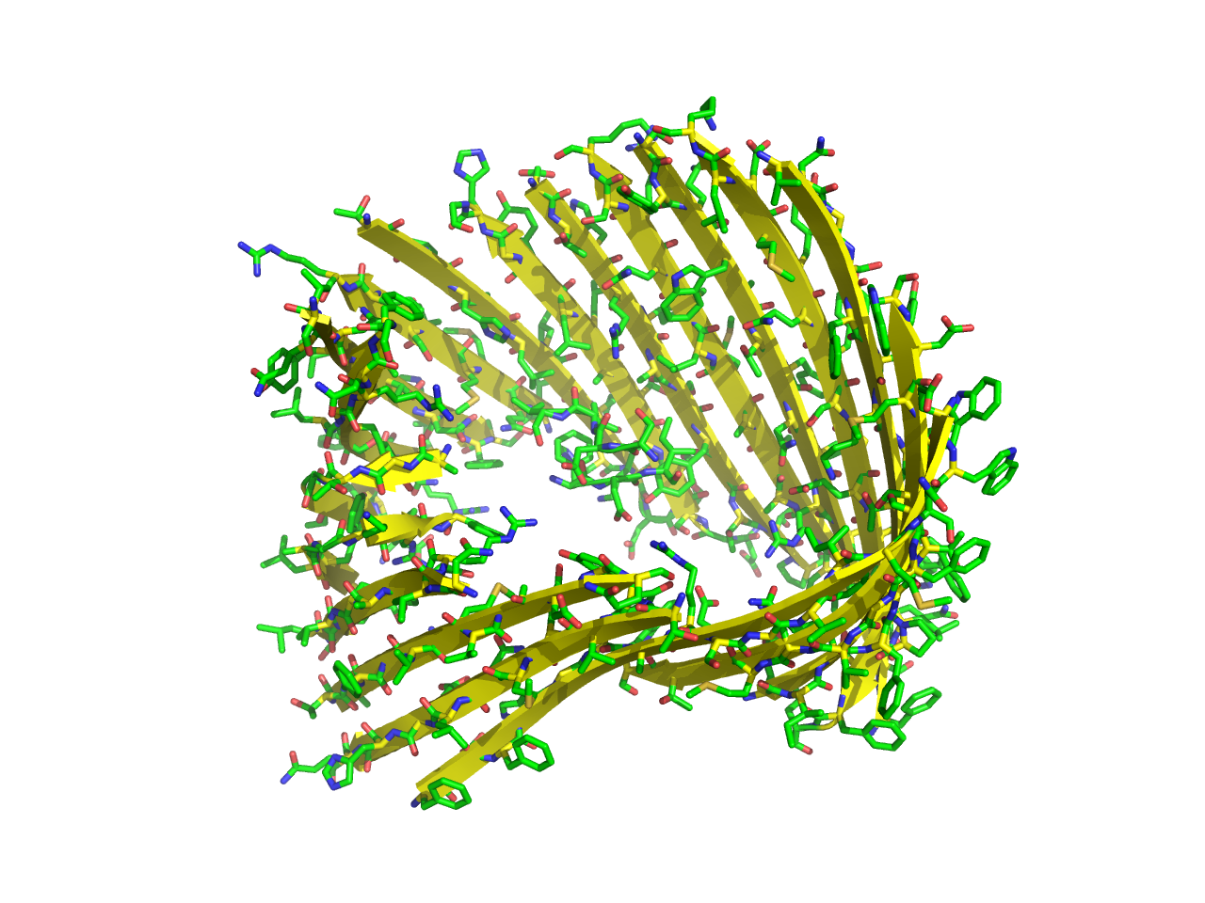
The Ezβ Moment Quantifies Local Elevation of Insertion Energy

Slide 10
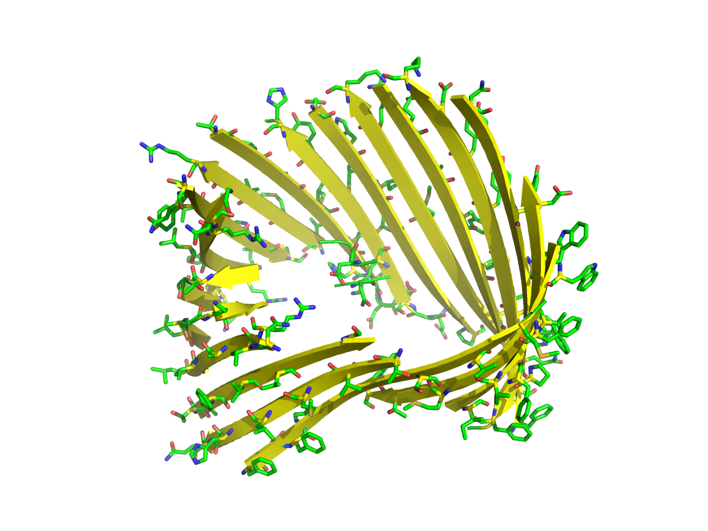
The Ezβ Moment Quantifies Local Elevation of Insertion Energy

Slide 11
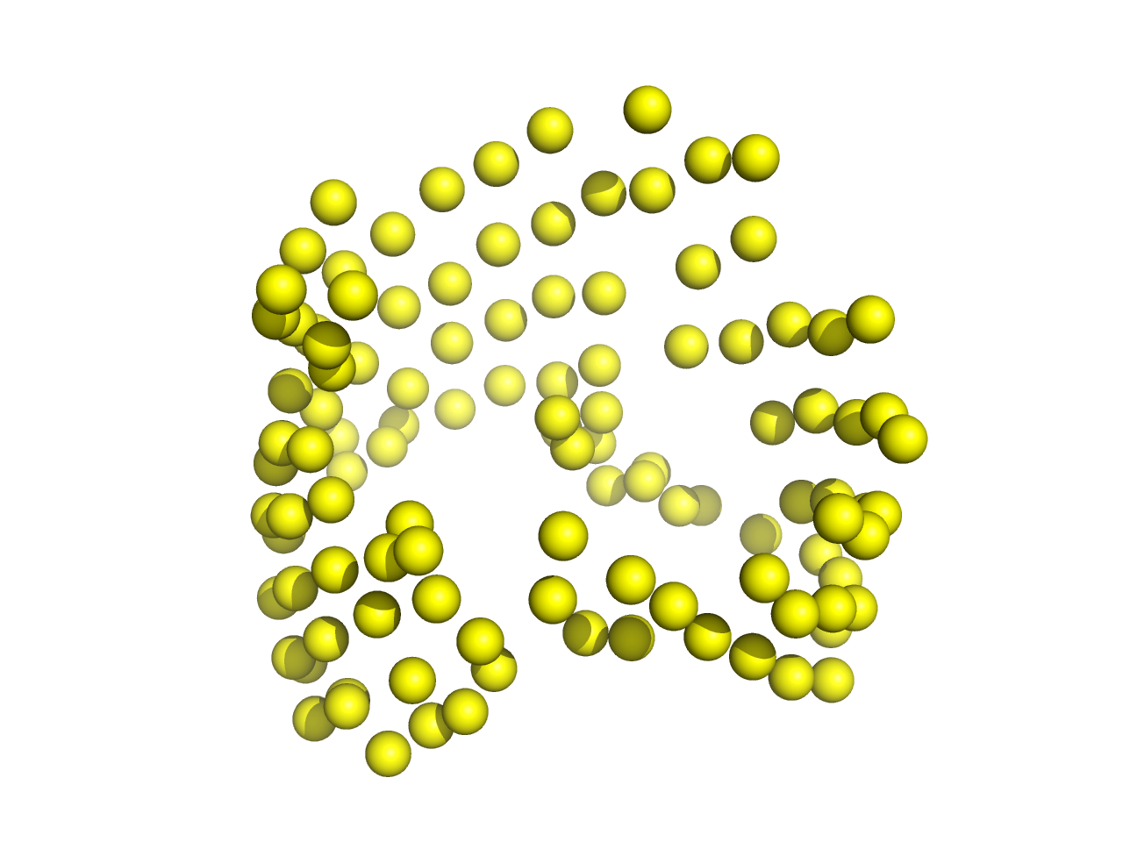
The Ezβ Moment Quantifies Local Elevation of Insertion Energy

Slide 12
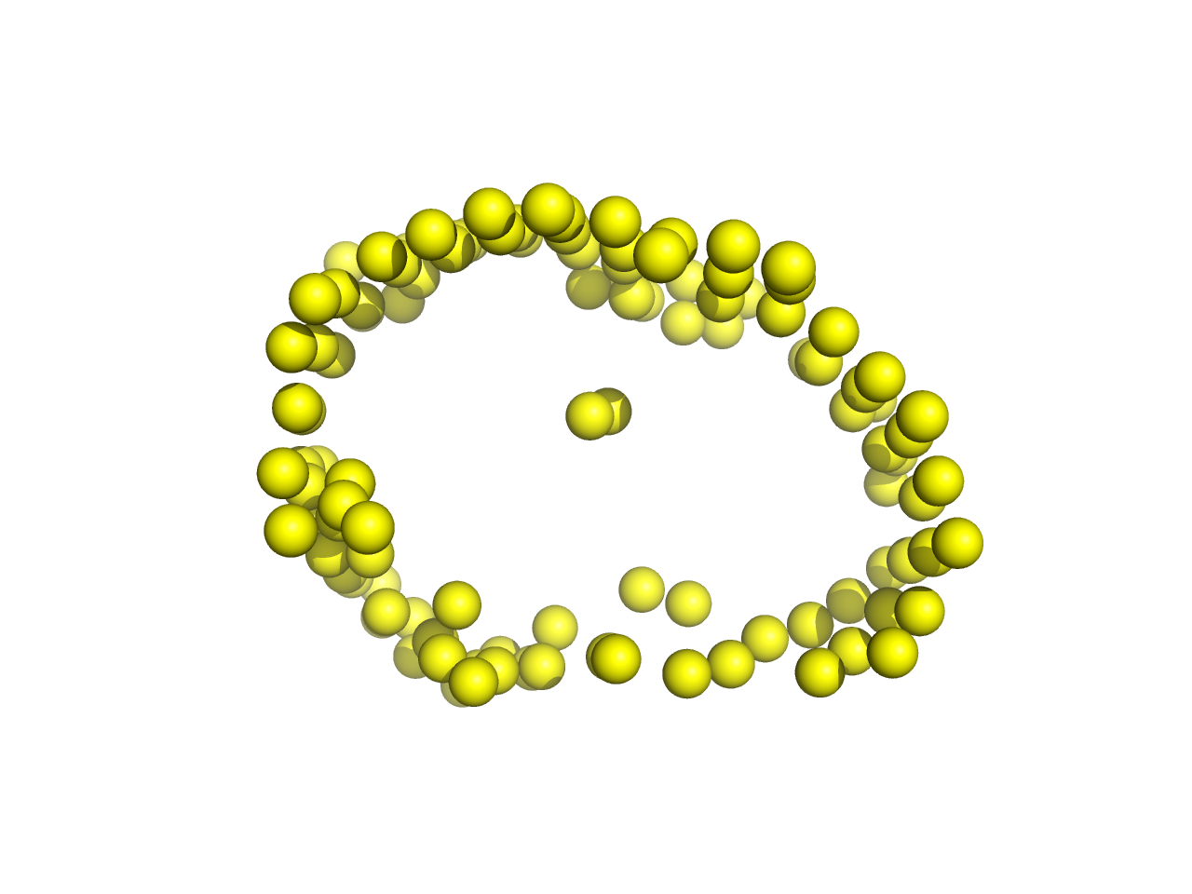
The Ezβ Moment Quantifies Local Elevation of Insertion Energy

Slide 13
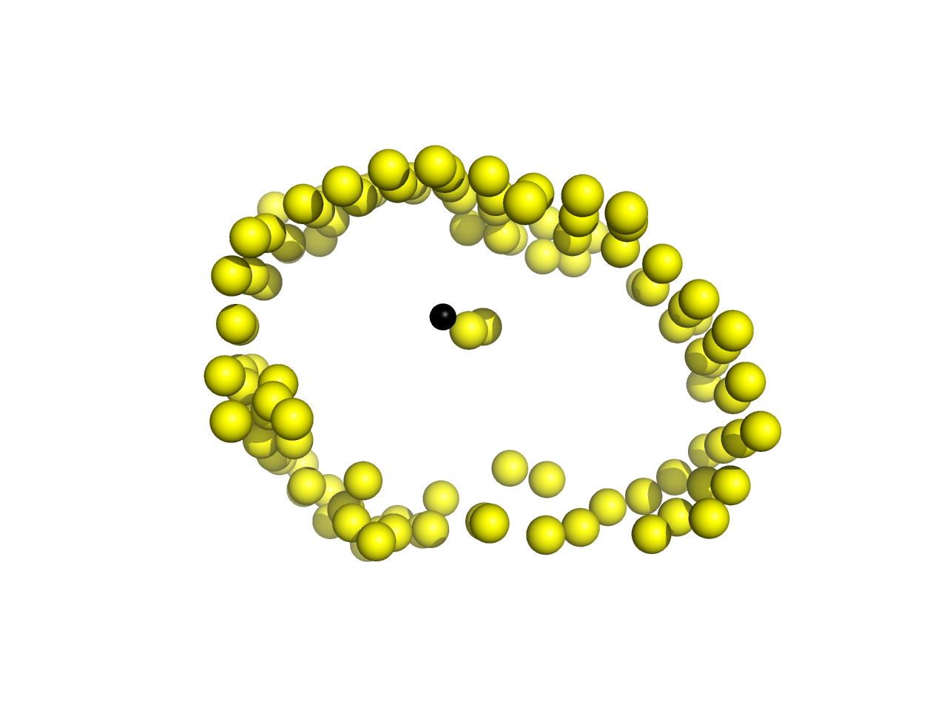
The Ezβ Moment Quantifies Local Elevation of Insertion Energy
.92
-1.8

